Slide 1
Final Project Presentation
Group: GogoZeppeli
Team members:
Chongcheng tang
Xing Dong
Yanshan Ban

Slide 2
Charity Material Management System

Slide 3
Problem Overview
There is no unified platform to access the information of schools in the poverty-stricken areas, it is difficult for people who want to donate to the school to communicate with them.
Donated resources may not match the needs of people in poverty-stricken areas, resulting in wasted resources.
The transportation of materials is also difficult due to the lack of convenient transportation and communication.

Slide 4
Solution
The platform can collect the contact information of various schools and charities, which can effectively solve the communication problem between them.
The platform makes the management of each process more systematic and effectively avoids the issue of resource waste and delivery.

Slide 5
Approach
The school sends requests to the charity through the platform.
The charity receives the request and then places an order with the factory.
After the factory completes the production of resources, the sales department will sell the resources to the school.
After the deal, the resources would be stored in the warehouse.
Then, the warehouse dispatched the resources to the school.
The school receives the resource and the order is completed.

Slide 6
Use Cases
System administrator
Registration
Manage Enterprises
Manage School, Charity, Manufactory, Storage and Sell organization
Manage employees in enterprises
Manage Requests
Manage networks

Slide 7
Use Cases
School
Send request to a specified charity
View request details
Receive order
Charity
Process requests from schools
Send the order to designated manufactory and storage
View the information of orders
Record the order hitory

Slide 8
Use Cases
Manufactory
Receive orders from charities
Produce Resources
View information of orders
Record the order history
Sell organization
Accept and sold orders
View the information of orders
Record the order hitory

Slide 9
Use Cases
Storage
Obtain and sold orders
View the information of orders
Record the order hitory

Slide 10
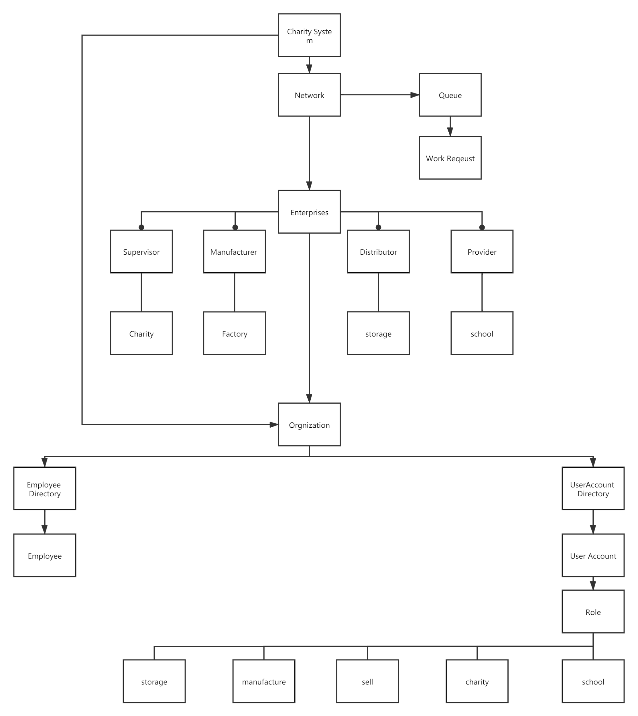
Eco-system
Architecture
Diagram

Slide 11
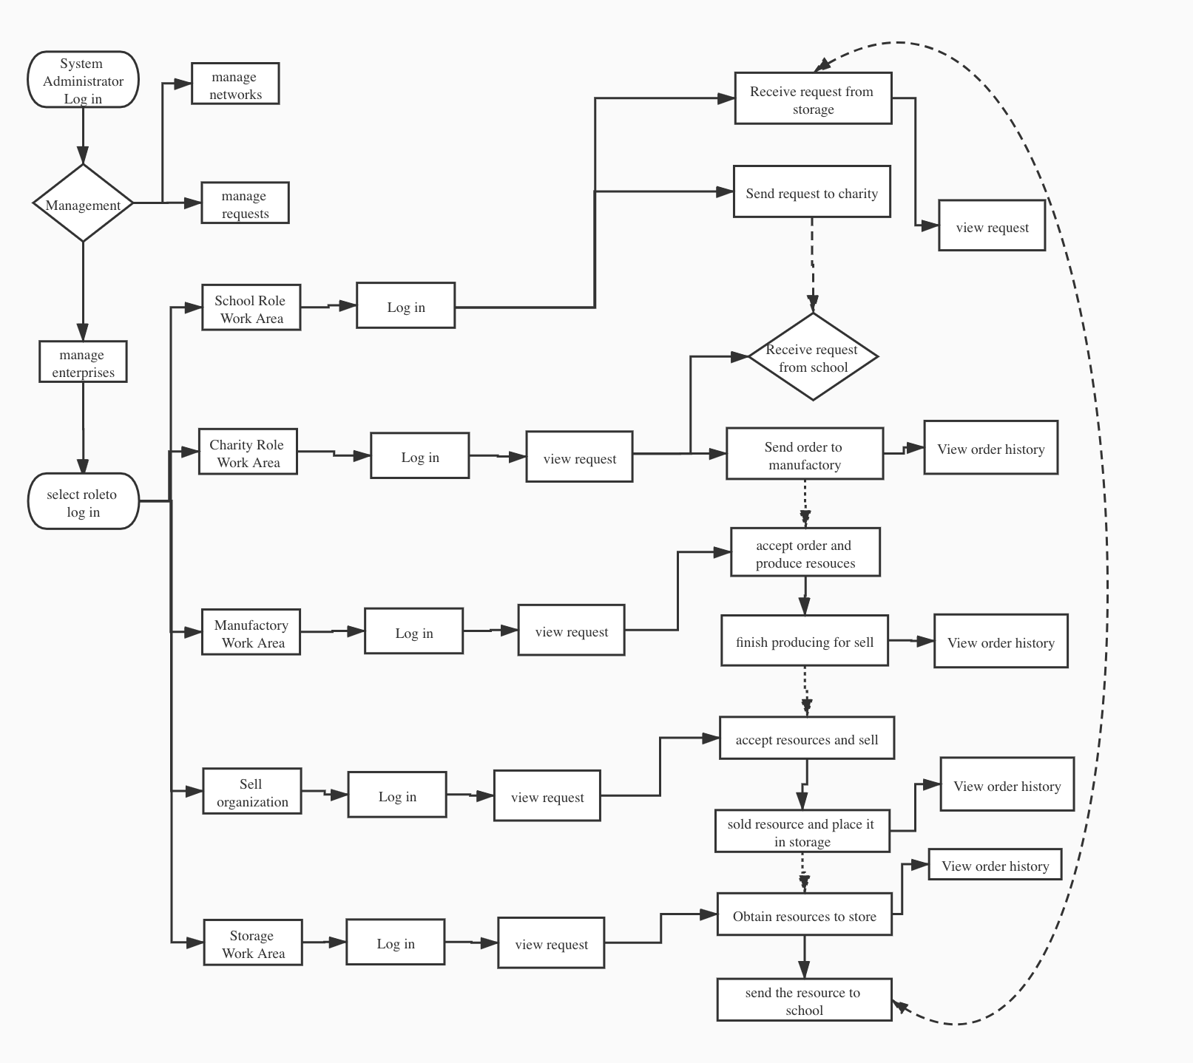
Workflow

Slide 12
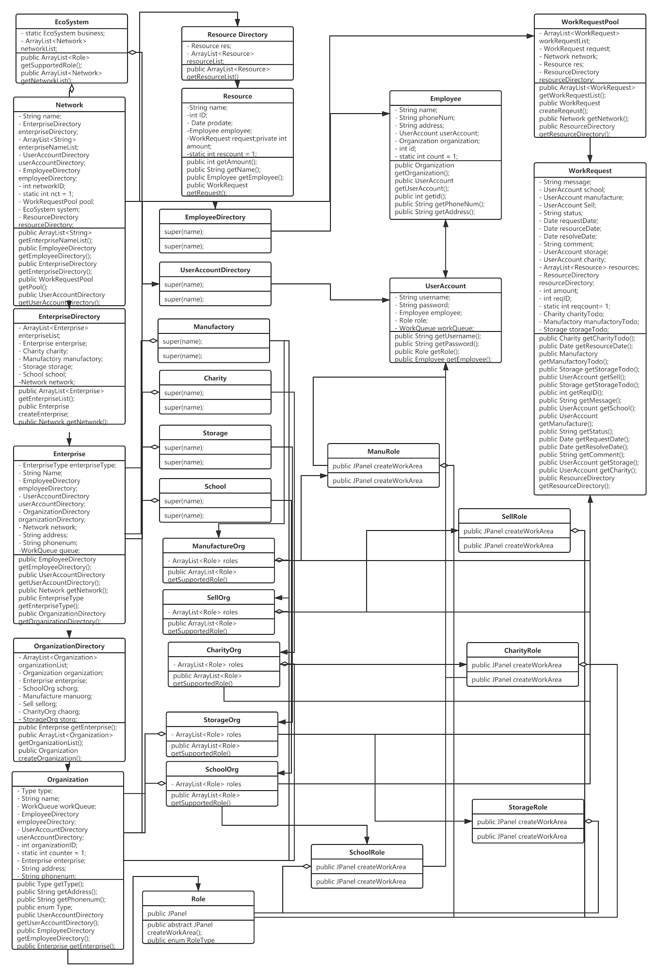
UML
Diagram

